Slide 1
Prediction Of Breast Cancer
Sepideh Khalili

Slide 2

BIO
● Data Scientist from DSIA
● Master Degree with Artificial Intelligence
● Bachelor Degree with Computer Science

Slide 3
AGENDA
01 Problem Definition
Business question vs. Data questions
02 DATA Process Design
Process Workflow
03 Values Delivery
EDA, Modelling Accuracy
04 Next Steps and Summary
Next Steps and Summary

Slide 4
AGENDA
01 Problem Definition
Business question vs. Data questions
02 DATA Process Design
Process Workflow
03 Values Delivery
EDA, Modelling accuracy
04 Next Steps and Summary
Next Steps and Summary

Slide 5



Overview:
Estimated number of new cases of breast cancer diagnosed in 2019
19,535 = 164 + 19,371
Average lifetime cost = $36,400
By saving 1000$ for each person → 19.5M$ will be saved
https://breast-cancer.canceraustralia.gov.au/statistics

Slide 6
- Business Question
- Data Question
How to detect BREAST CANCER fast and accurate,
as much as possible ?
What model could be used to detect BREAST CANCER more accurate and fast?

Slide 7
- Stakeholder
Ryan Alexander
Director, Finance and Corporate Services of Cancer Council
- Breast Cancer Proteomes
https://www.kaggle.com/piotrgrabo/breastcancerproteomes
- Histopathologic Cancer Detection
https://www.kaggle.com/c/histopathologic-cancer-detection/data

Slide 8
AGENDA
01 Problem Definition
Business question vs. Data questions
02 DATA Process Design
Process Workflow
03 Values Delivery
EDA, Modelling Accuracy
04 Next Steps and Summary
Next Steps and Summary

Slide 9
Business Questions
EDA
DATA QUESTIONS
Process Workflow
Modelling
Feature Engineering
Validation
Testing

Slide 10
AGENDA
01 Problem Definition
Business question vs. Data questions
02 DATA Process Design
Process Workflow
03 Values Delivery
EDA, Modelling Accuracy
04 Next Steps and Summary
Next Steps and Summary

Slide 11
Detect Type Of Breast Cancer
4 Different Tumours
Samples
12000 Genes
Feature Selection

Slide 12
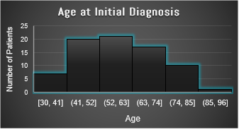
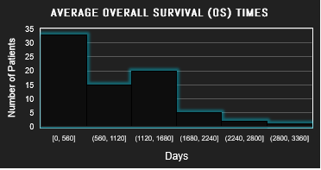

Slide 13
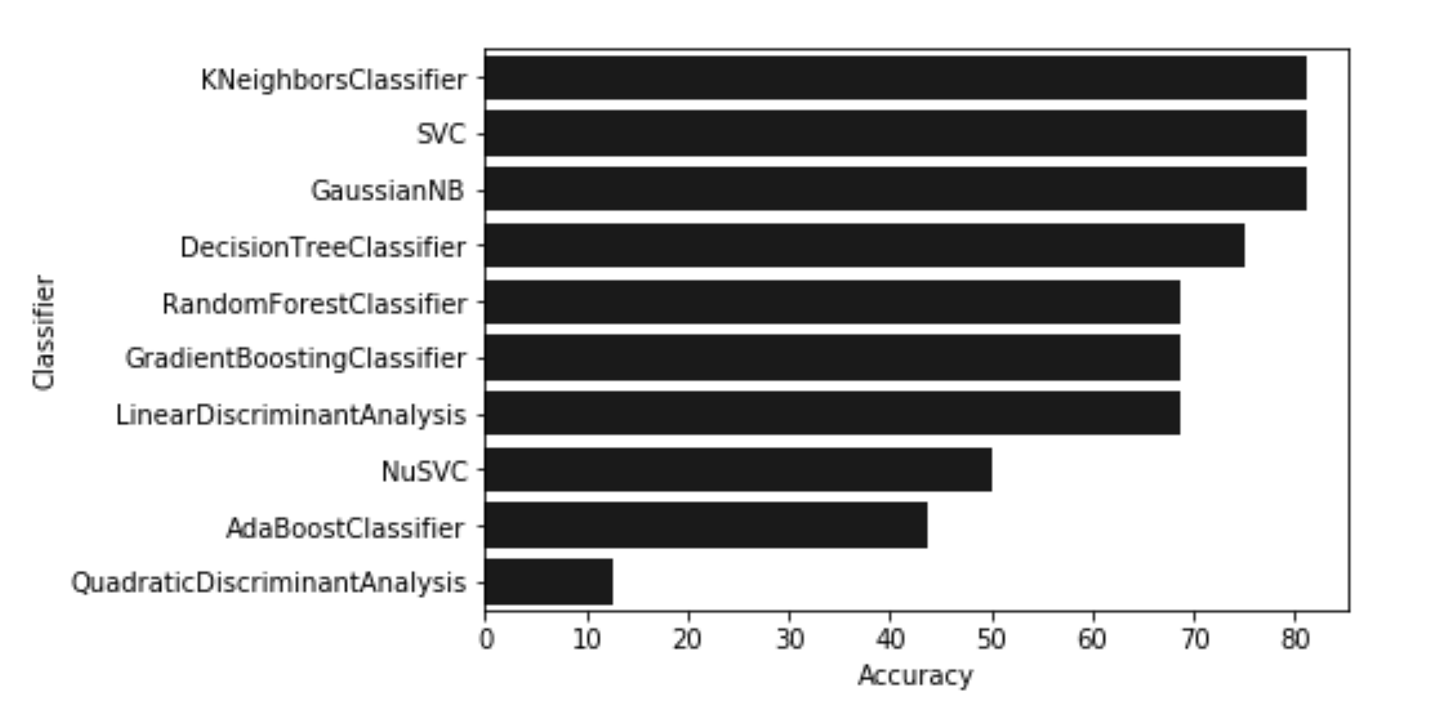
Final Accuracy
Baseline(most frequent) 31%
KNeighborsclassifier 81.25%

Slide 14
Histopathologic Cancer Detection
220K images
Deep Learning
Transfer Learning
Preprocessing and Augmentation
Fine-Tuning

Slide 15
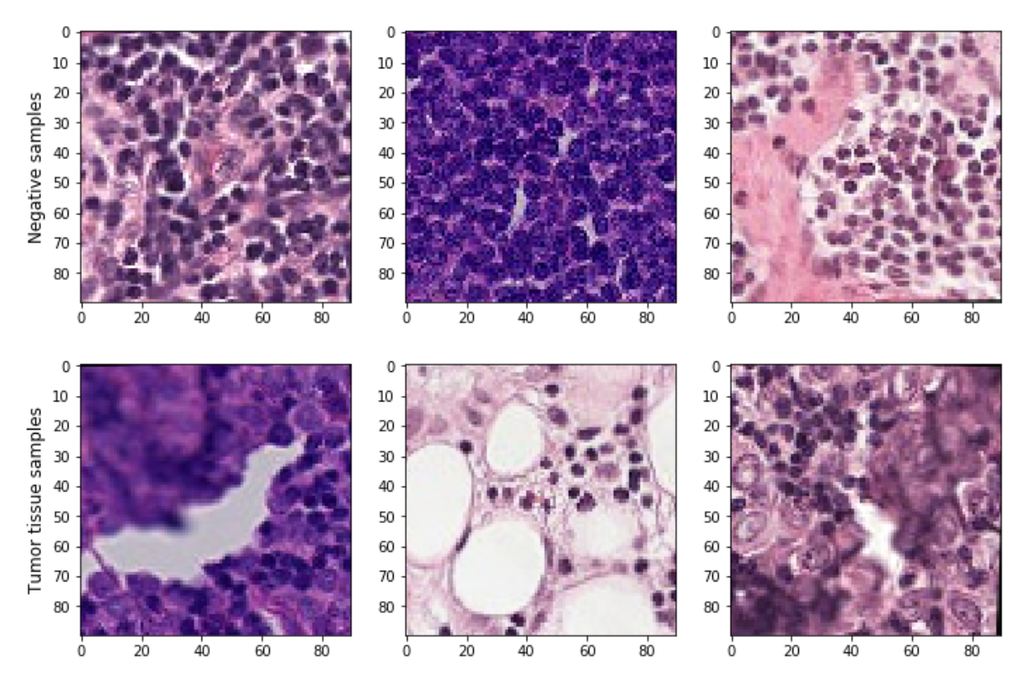
Some images with and without cancer tissue

Slide 16
Final Accuracy
Method | Algorithm | Accuracy
Deep Learning /Transfer Learning | VGG16 Network | 92.51%
Deep Learning | Convolutional Neural Network | 88.46%
Deep Learning /Transfer Learning | NasNet Mobile Network | 78.62%
Deep Learning /Transfer Learning | InceptionV3 Network | 65.21%

Slide 17
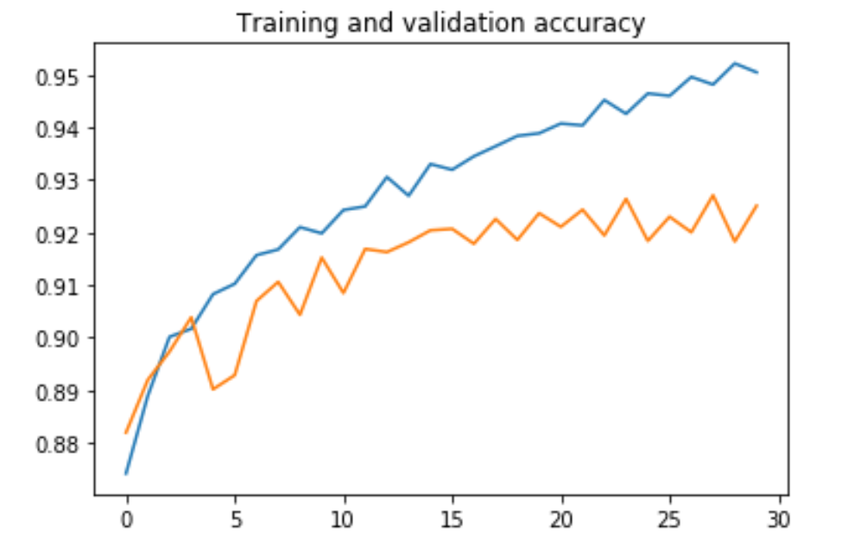
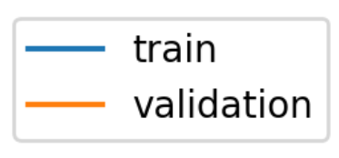
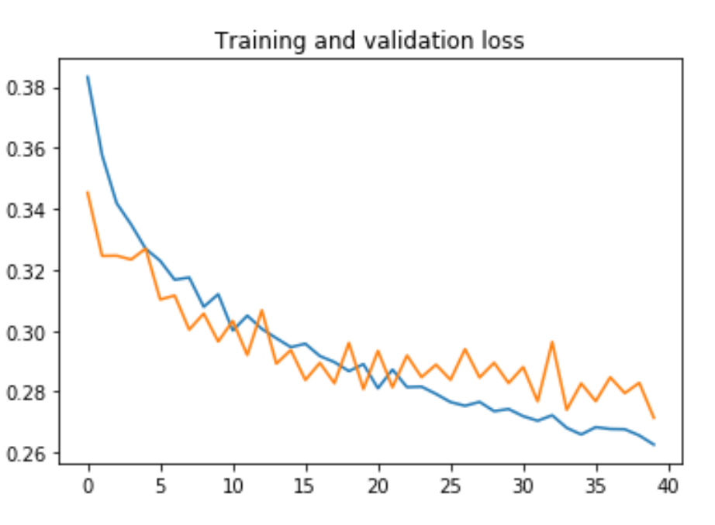
Training Learning Curve For VGG16 Network
Accuracy
Epoch
Loss
Epoch

Slide 18
AGENDA
01 Problem Definition
Business question vs. Data questions
02 DATA Process Design
Process Workflow
03 Values Delivery
Modelling Accuracy
04 Next Steps and Summary
Next Steps and Summary

Slide 19
Business Questions
EDA
DATA QUESTIONS
Summary
220K images
Modelling
4 Different Tumours
Deep Learning
77 Samples
12000 Genes
Transfer Learning
Preprocessing and Augmentation
Feature Selection
Feature Engineering
Fine-Tuning
Validation
Testing
Algorithm Kneighborsclassifier
Accuracy
81.25%
Model Accuracy Deep Learning
/Transfer Learning
VGG16 92.51%

Slide 20
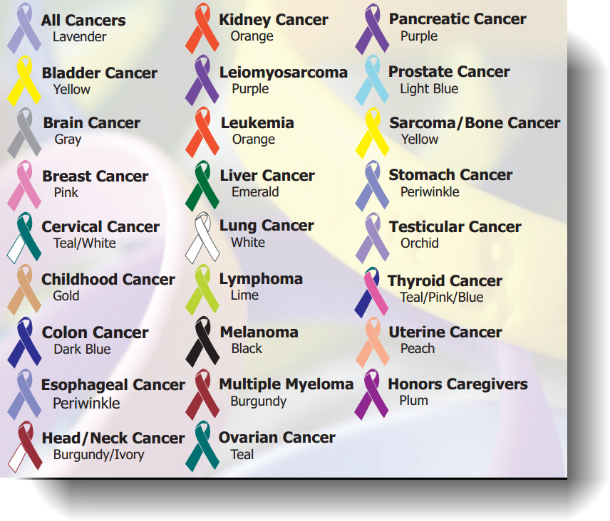
Next Steps
Apply Unsupervised Methods
High numbers of clusters
Feature selection
Combine Genes and Pathology Scans Information
Transfer Learning
Similar models can be applied in all cancers and other diseases

Slide 21
References
https://www.cancercouncil.com.au/breast-cancer/
https://www.cancercouncil.com.au/breast-cancer/diagnosis/
https://www.cancercouncil.com.au/
https://www.zurich.com.au/advisers/news/risk-pulse/2018/the-cost-of-care-part-1-of-3-the-cost-of-cancer.html
https://www.bcna.org.au/media/5608/financial-impacts-of-breast-cancer-deloitte-access-economics.pdf

Slide 22
Thanks
Does anyone have any questions?
Sepideh_khaliliborujeni@yahoo.com
https://github.com/sepidehkhb/DSIA-SYD-FT-Projects-201907/tree/master/Sepideh

